Slide 1
RoboApp Demo 1
Dr. RoboDoot and the NP Hardcoders
Joel Huff, John Huff, and Eddie Kerbler

Slide 2
Start-Up Code
Done by Team RoboApp

Slide 3
Final Project had ERRORS
NDK Issues
Android Studio Version Issues
Gradle Build Issues
No Working Starting App

Slide 4
Informal Requirements

Slide 5
Graphical User Interface
Improve Navigation
Make Individual Servo Sliders Work Better
Add Cat Face with possible emotion control based on sound and sight

Slide 6

OpenCV
Get Facial Recognition to work in vertical orientation
Add Shape and Color Recognition
Get Position of face in order to mover servos and point camera towards face. (Stare Mode)

Slide 7
Hardware Communication
Allow phone to communicate with the Arduino Mega and Polulu via the USB cord.
Allow communication simultaneously to both
Fix hardware modules to send correct communication to hardware

Slide 8
Software/Hardware Tehnology

Slide 9
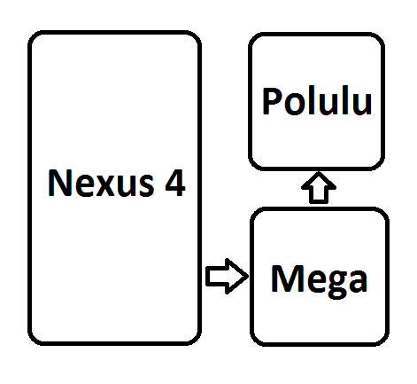
RoboCat
Arduino Mega
Polulu
Servos to control leg and neck movement
Samsung Google Nexus 4

Slide 10
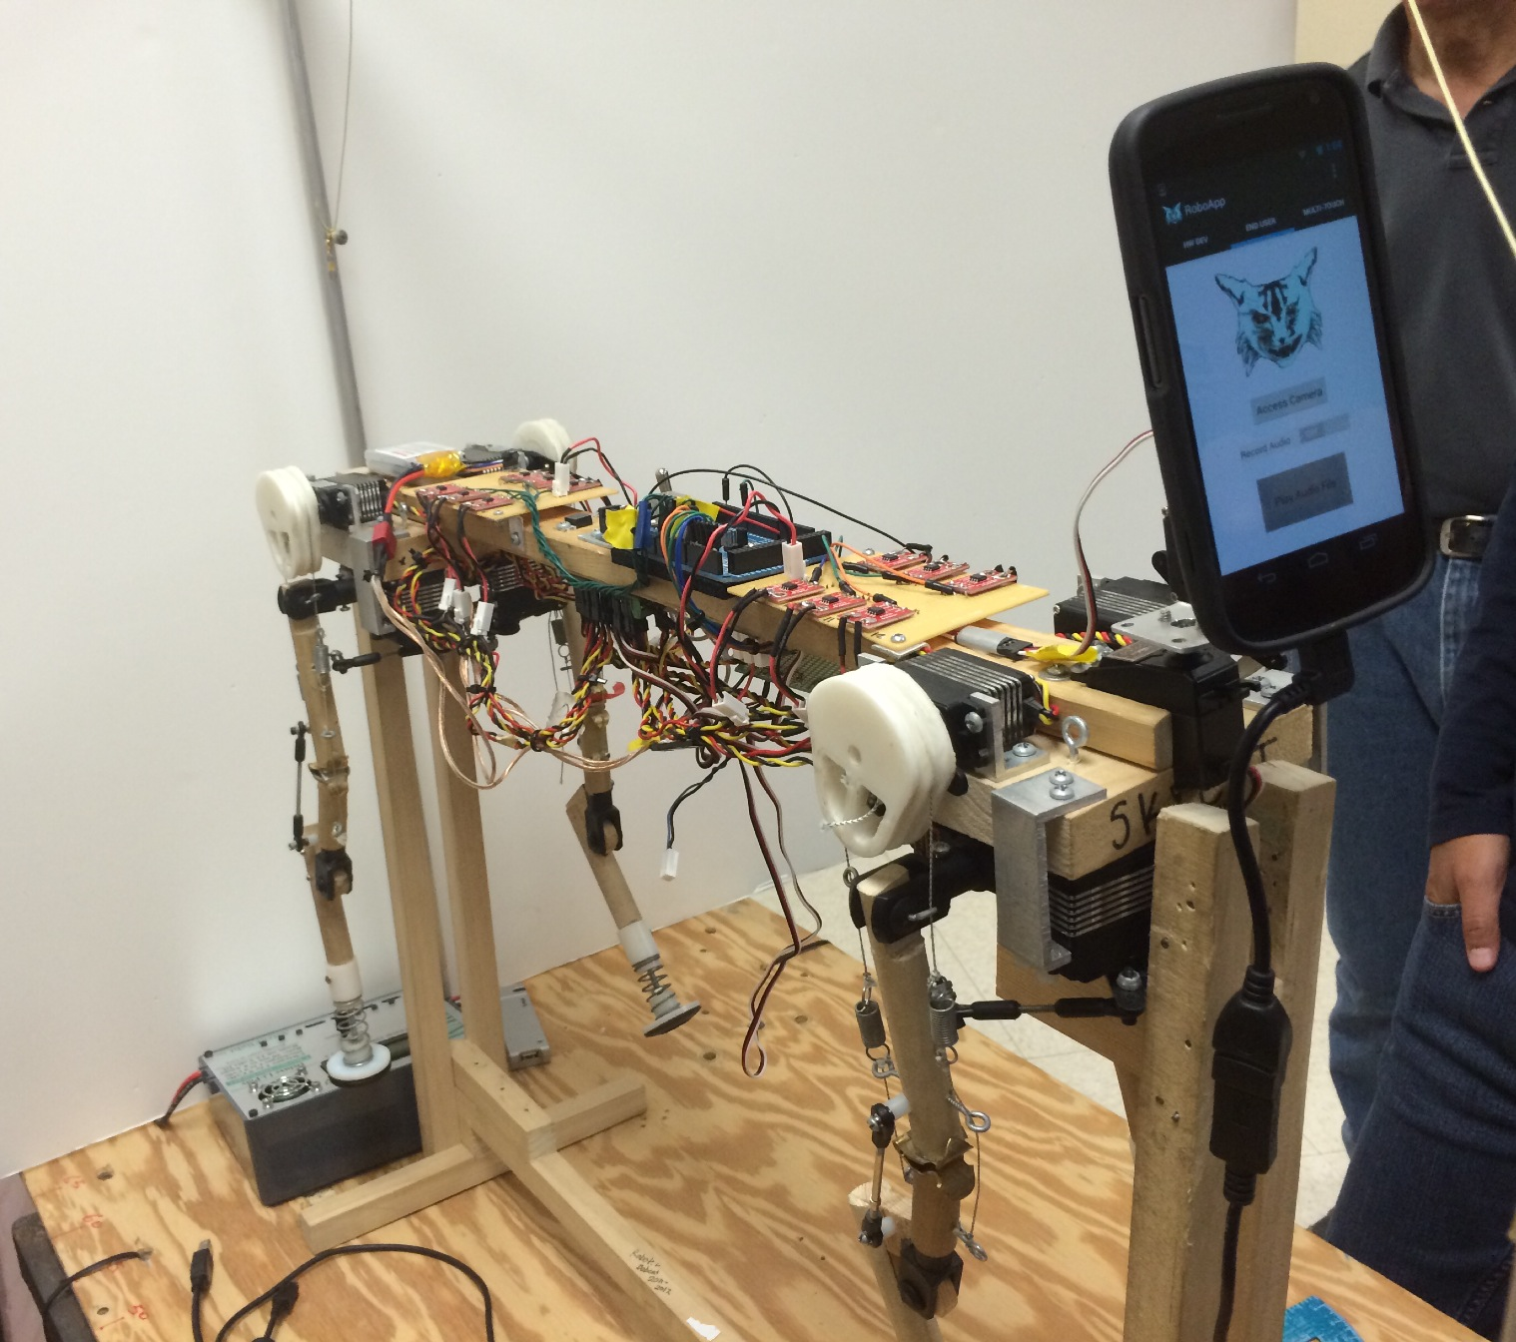
The Cat
Shoulders have been redesigned since this picture

Slide 11
Software
Android Studio
OpenCV
Google Material Design (Link)

Slide 12
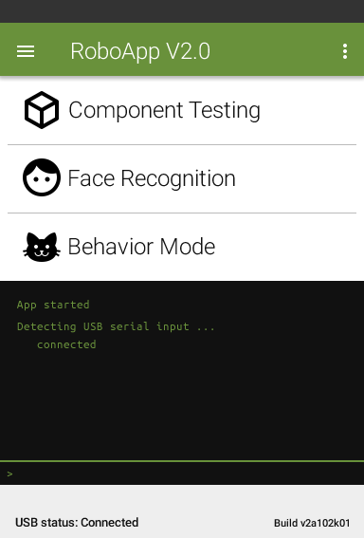
UI Home Page

Slide 13
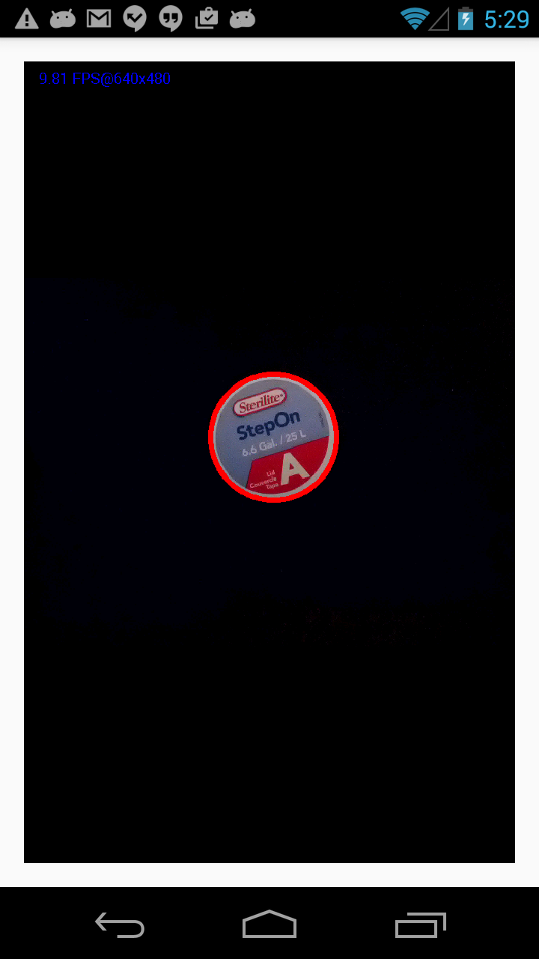
Shape Recognition
Circle Example

